Slide 1
Contributions to Team Project: XAI In Cybersecurity
Name: Ambika Taploo
12-03-2024

Slide 2
Introduction
Objective: Enhancing explainability in AI models to improve security decisions
Team Members: Raghunandan, Hetav, Tejas, Kaniz, Srujan, Devang, Ambika
Overview of the Project:
Focuses on integrating Explainable AI (XAI) into cybersecurity systems
Explores hierarchical explanations and human-centric usability improvements for security operations.
Contribution:
Problem definition and Research question
Kairos Code implementation
Usability explanations
Notes:
Imagine detecting malware is like identifying a suspect in a large crowd. Feature correlations are the clues we use to narrow down the suspects. If the clues are misleading or incomplete, the real threat might escape detection."

Slide 3
Objective of presentation
My contributions to the problem definition, code implementation, and usability explanations
Key learnings and challenges encountered
The novel insights gained and their potential impact on advancing XAI in cybersecurity
Notes:
In this project, I contributed to multiple stages, from defining the problem and research questions to implementing and running the code end-to-end. I also worked on human usability explanations, proofreading, and validating findings. This presentation will outline the learnings from these activities, the challenges faced during implementation, and the innovative solutions we proposed. I'll also connect these efforts to the broader goal of improving cybersecurity with Explainable AI.

Slide 4
Literature Survey
References
Saqib, M., et al., "A Comprehensive Analysis of Explainable AI for Malware Hunting".
Jeon, H. & Moon, S., "Malware Detection Using Deep Learning and Correlation-Based Feature Selection".
Liyanage, L., et al., "SoK: Identifying Limitations and Bridging Gaps of Cybersecurity Capability Maturity Models".
Yazdinejad, A., et al., "Malware Detection Using Feature Selection and Deep Learning".
1. Jeon, H. & Moon, S., "Malware Detection Using Deep Learning and Correlation-Based Feature Selection”
Focus: This paper presents a hybrid malware detection approach combining deep learning with correlation-based feature selection to reduce irrelevant features while maintaining detection accuracy.
Key Contributions:
Introduced a feature selection method that identifies highly correlated features relevant to malware behaviors.
Enhanced model performance by reducing noise from unrelated features, which often lead to misclassifications.
Findings:
Correlation-based methods improve the interpretability of selected features, aiding cybersecurity teams in understanding the basis for detection decisions.
Demonstrated a trade-off between feature reduction and detection accuracy, with an optimal balance enhancing real-time detection.
Challenges Identified:
Difficulty in handling dynamic malware due to evolving attack patterns.
Computational overhead when processing large datasets.

Slide 5
Literature Survey
2. Liyanage, L., et al., "SoK: Identifying Limitations and Bridging Gaps of Cybersecurity Capability Maturity Models”
Focus: A Systematization of Knowledge (SoK) that examines existing cybersecurity capability maturity models (CMMs), highlighting gaps and proposing strategies to address them.
Key Insights:
CMMs often fail to incorporate human-centric approaches, particularly in explainability and decision-making workflows.
The paper emphasizes the need for models that adapt to real-world constraints such as data sparsity, operational requirements, and temporal feature dependencies.
Relevance to Malware Detection:
Aligns with the need for XAI methods that can explain decisions in operational contexts, enhancing analyst trust.
Suggests integrating explainable methods within CMMs to improve usability and alignment with security objectives.
3. Yazdinejad, A., et al., "Malware Detection Using Feature Selection and Deep Learning”
Focus: This study explores how feature selection techniques combined with deep learning can improve malware detection accuracy and efficiency.
Key Insights:
Proposed a novel feature selection algorithm that prioritizes features based on their contribution to detection accuracy.
Demonstrated significant reductions in training times while maintaining high accuracy.
Challenges and Limitations:
Feature selection methods may inadvertently remove subtle correlations critical for detecting advanced malware variants.
Overfitting concerns when deep learning models are trained on limited or biased datasets.

Slide 6
Literature Survey
References
Saqib, M., et al., "A Comprehensive Analysis of Explainable AI for Malware Hunting".
Jeon, H. & Moon, S., "Malware Detection Using Deep Learning and Correlation-Based Feature Selection".
Liyanage, L., et al., "SoK: Identifying Limitations and Bridging Gaps of Cybersecurity Capability Maturity Models".
Yazdinejad, A., et al., "Malware Detection Using Feature Selection and Deep Learning".
1. Jeon, H. & Moon, S., "Malware Detection Using Deep Learning and Correlation-Based Feature Selection"
Focus: This paper presents a hybrid malware detection approach combining deep learning with correlation-based feature selection to reduce irrelevant features while maintaining detection accuracy.
Key Contributions:
Introduced a feature selection method that identifies highly correlated features relevant to malware behaviors.
Enhanced model performance by reducing noise from unrelated features, which often lead to misclassifications.
Findings:
Correlation-based methods improve the interpretability of selected features, aiding cybersecurity teams in understanding the basis for detection decisions.
Demonstrated a trade-off between feature reduction and detection accuracy, with an optimal balance enhancing real-time detection.
Challenges Identified:
Difficulty in handling dynamic malware due to evolving attack patterns.
Computational overhead when processing large datasets.

Slide 7
Problem definition and Research question
How do limitations in feature correlations affect security decisions like malware detection?
Limitations in Feature Correlations
High Dimensionality: Large datasets with numerous features demand substantial computational resources, making it challenging to effectively manage these correlations.
Spurious Correlations: Models often identify irrelevant or non-linear correlations, which mimic malicious activity and lead to incorrect classifications.
Overfitting: Some deep learning models rely excessively on specific feature patterns in the training data, limiting their ability to detect new malware variants.
Lack of Interpretability: Especially with deep learning, it can be unclear why certain features contribute to decisions, reducing trust in the model."
Notes:
"Feature correlation plays a crucial role in identifying malware effectively. However, limitations in these correlations can lead to inaccuracies. My research question aims to explore how such limitations influence key security decisions."
Emphasize why addressing this RQ is vital for developing robust security solutions.

Slide 8
Problem definition and Research question
Implications of Ignoring These Limitations
Missed Threats: Unaddressed weak correlations can allow sophisticated malware to go undetected, posing severe security risks.
Alert Fatigue: High false positive rates overwhelm teams, diverting focus from real threats.
Advanced Malware Vulnerabilities: Attackers can exploit gaps in feature correlation methodologies to bypass detection.
Lack of Actionable Insights: Poor interpretability of models prevents actionable decisions by security teams.
Based on these gaps, a potential research question is:
"How can Explainable AI (XAI) improve feature correlation methods to reduce false positives and negatives in dynamic malware detection systems?"

Slide 9
Problem definition and Research question
Improving Feature Importance Analysis
Current Challenge: Deep learning models often operate as black boxes, making it difficult to understand the importance of individual features or correlations.
XAI Contribution: Techniques like SHAP (SHapley Additive exPlanations) or LIME (Local Interpretable Model-Agnostic Explanations) can identify which features contribute most to a decision. This enables researchers to distinguish between irrelevant features and critical indicators of malware.
Enhancing Model Robustness
Current Challenge: Models are prone to overfitting, often relying on patterns in training data that do not generalize well to new malware.
XAI Contribution: Post-hoc explanation tools can expose such over-reliance on non-generalizable correlations. Identifying these can guide feature engineering efforts, leading to more robust models that avoid false negatives.
Combating Adversarial Attacks
Current Challenge: Malware authors exploit model vulnerabilities by injecting misleading features that bypass detection.
XAI Contribution: By generating counterfactual explanations, XAI can simulate "what-if" scenarios to identify how minor feature manipulations affect decisions. This helps in recognizing and mitigating adversarial techniques that exploit spurious correlations.
Notes:
Example:
In malware detection, SHAP could highlight that "process injection patterns" were more indicative of malicious activity than "high memory usage," reducing false positives.
Example:
XAI can reveal that certain models misclassify malware families with novel behaviors because they ignored temporal feature correlations.

Slide 10
Problem definition and Research question
Improving Trust and Usability
Current Challenge: Security analysts often distrust AI systems due to their opaque decision-making processes.
XAI Contribution: Providing interpretable outputs that explain why a model classified a file as malicious or benign increases analysts' confidence. For example, XAI methods can visualize feature interactions, such as how specific API calls combined with network activity contribute to detection.
Reducing False Positives and Negatives
False Positives: XAI techniques refine feature selection by distinguishing meaningful correlations from noise, reducing unnecessary alerts.
False Negatives: By analyzing and explaining misclassifications, XAI can help uncover overlooked features or interactions, improving detection rates for complex malware.
Dynamic Analysis Support
Current Challenge: Static feature analysis often fails to capture evolving malware patterns.
XAI Contribution: Temporal XAI methods can correlate time-based features like event sequences or recurring patterns, aiding in dynamic malware detection.

Slide 11
Problem definition and Research question
Case Studies from Literature
Jeon & Moon (2020): Highlighted how correlation-based feature selection, when augmented with explainable methods, improved malware detection accuracy by up to 15% through reduced noise.
Saqib et al. (2023): Demonstrated the value of hierarchical explanations in improving interpretability for complex cybersecurity tasks, enabling analysts to better understand feature importance.
Yazdinejad et al. (2022): Showed that combining XAI with feature selection improved generalization, reducing false negatives in unseen malware variants.
Explainable AI bridges the gap between complex model outputs and human decision-making, transforming feature correlations into actionable insights. By uncovering hidden patterns, debunking spurious correlations, and enhancing trust, XAI is pivotal in creating robust, efficient, and interpretable malware detection systems.

Slide 12
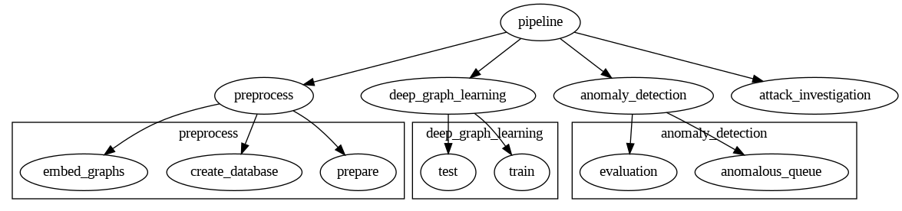
Running Existing Code E2E
Notes:
started by understanding the functionality of the black box code. To achieve E2E execution, I debugged issues, ensured dependencies were correctly configured, and introduced changes to optimize performance.

Slide 13
Running Existing Code E2E
How does existing code work
Preprocess:
Preparation Stage: Creates a directory named artifact to store outputs, logs, or intermediate files produced during the pipeline.
Database Creation
Data Sources: Log files contain data about network flows, subjects, files, and events.
Data Extraction: Regex patterns are used to extract relevant fields (UUIDs, IP addresses, timestamps).
Data Hashing: MD5 hashing (using SHA-256) creates unique identifiers for objects to ensure uniqueness.
Tables: Three main tables store data:
netflow_node_table: Stores network flow details.
subject_node_table: Stores subject-related information.
file_node_table: Stores file-related objects.
Event Relationship: The event_table stores relationships between nodes (e.g., subjects interacting with files or network flows).
Database Insertion: Bulk insertion with execute_values ensures efficient handling of large datasets.
Optimization: Use of batch processing and conflict handling (ON CONFLICT DO NOTHING) to avoid duplicates and improve performance.
Notes:
started by understanding the functionality of the black box code. To achieve E2E execution, I debugged issues, ensured dependencies were correctly configured, and introduced changes to optimize performance.

Slide 14
Running Existing Code E2E
Graph Embedding
Logging: Logs are set up to track the feature generation and graph embedding process.
Node Feature Extraction:
Hierarchical Representation: IPs and file paths are split into hierarchical lists.
Feature Hashing: Uses FeatureHasher to convert node labels into fixed-length feature vectors.
Relation Vectorization:
One-hot Encoding: Relations between nodes are converted into one-hot vectors using torch.nn.functional.one_hot.
Relation-Node Encoding: Combined vectors from node embeddings and relation embeddings to represent node interactions.
Graph Generation:
Event Data Processing: Events from a database are filtered by timestamp and type.
Edge Construction: Edges are created based on valid relationships (e.g., file interactions, network flows).
Temporal Data: Graphs are created for specific days, with messages combining node features and relations.
Dataset Construction:
Temporal Data Format: Constructs temporal graphs with source, destination, timestamp, and message attributes.
Efficient Storage: Only valid graphs (with messages) are saved in the specified directory.

Slide 15
Running Existing Code E2E
Learning:
Training
Logging Setup: Tracks training progress and logs loss values.
Model Training:
Utilizes Temporal Graph Neural Networks (TGN).
Memory Module: Updates node state with TGNMemory.
Graph Neural Network (GNN): Applies Graph Attention for embeddings (GraphAttentionEmbedding).
Link Prediction: Predicts links between nodes using LinkPredictor.
Training Loop:
Batches data for training and updates model parameters using Adam optimizer.
Loss calculated using predicted vs true values and backpropagated for model improvement.
Data Loading: Loads preprocessed temporal graph data for training (load_train_data).
Model Initialization: Initializes models, optimizer, and neighbor loader (init_models).
Model Saving: Saves the trained model to a specified directory.

Slide 16
Running Existing Code E2E
Learning:
Testing
Logging Setup: Tracks and logs the reconstruction process, including loss and edge details.
Edge Reconstruction:
Test Function: Runs inference on data to reconstruct edges, compute losses, and save the results.
Memory & GNN: Evaluates the model (memory, GNN, and link prediction) for edge predictions.
Loss Calculation: For each batch, calculates the loss using predicted and true values for node pairs, and records detailed edge loss information.
Edge Details: Collects details about each edge, including loss, source/destination nodes, messages, edge types, and timestamps.
Performance Logging:
Records time and loss for each time window (checkpoint).
Saves detailed logs and ranked edge losses for later evaluation.
Model Evaluation:
Evaluates the model on multiple graph datasets (graph_4_3, graph_4_4, graph_4_5, etc.) to reconstruct edges.
Saves the results at each time checkpoint for performance analysis.
Data and Model:
Loads node ID-to-message mappings and graph data for inference.
Loads the trained models from the saved directory to perform edge reconstruction.

Slide 17
Running Existing Code E2E
Anomaly Detection
Anomalous Queue Construction
Logging Setup:
Configured logging for tracking anomalous events.
Logs details like time, loss, anomalous node count, and edge count for each time window.
Anomaly Detection:
Loss Threshold: Anomalous edges identified based on loss exceeding a threshold (mean + 1.5 * standard deviation).
IDF Calculation: Uses Inverse Document Frequency (IDF) to measure node rarity across time windows, helping identify anomalies.
Node Set Filtering: Common and noisy nodes are excluded from anomaly detection (e.g., system files, logs).
Anomalous Queue Construction:
Incremental Queue Building: Anomalous queues are updated incrementally by comparing current and past time windows.
Edge and Node Analysis: Anomalous edges and nodes are flagged and analyzed in terms of their loss and frequency.
History Tracking: Builds a history of anomalies, capturing shifts in node interactions over time.
Data Handling and Results:
Processes multiple datasets (graph_4_3, graph_4_4, etc.) to identify anomalies.
Saves the results as .pt files for future analysis.
Metrics and Reporting:
Edge Loss Calculation: Identifies anomalous edges based on loss.
Anomalous Edge/Node Count: Logs the number and percentage of anomalous edges and nodes.
Anomalous Queue Updates: Constructs and maintains a queue of anomalous nodes based on their relationship across time windows.

Slide 18
Running Existing Code E2E
Anomaly Detection
Evaluation
Logging Setup:
Configured a logger for tracking evaluation metrics.
Logs confusion matrix, precision, recall, F1-score, accuracy, and AUC for classifier performance.
Classifier Evaluation:
Confusion Matrix: Calculates true positives, false positives, true negatives, and false negatives.
Metrics Calculation: Computes precision, recall, F1-score, accuracy, and AUC to assess the model's performance.
Outputs: Displays all evaluation metrics and logs the results for both training and test datasets.
Ground Truth Labeling:
Normal Labels: Default labels set to 0 for files from specific directories (graph_4_4, graph_4_7).
Attack Labels: Assigns label 1 to files from known attack sequences.
Attack Edge Calculation:
Keyword-based Detection: Identifies attack edges by searching for specific keywords (e.g., IP addresses, domain names) in the log files.
Count Attack Edges: Logs the number of edges corresponding to potential attacks.
Anomalous Queue Construction:
Anomaly Scoring: Each time window's anomaly score is calculated based on the loss.
Thresholding: If the anomaly score exceeds predefined thresholds (beta_day6, beta_day7), it is flagged as anomalous.
Prediction Labels: For time windows where anomaly scores are high, files are labeled as anomalous.
Metrics and Reporting:
Evaluation: Compares predicted labels (pred_label) with ground truth labels (labels) and logs evaluation results.
Missing Files Warning: Logs a warning if any files in the ground truth are missing in the predictions.
Attack Investigation

Slide 19
Running Existing Code E2E
Attack Investigation
Path Abstraction:
Replaces sensitive file paths with wildcard patterns to ensure privacy during graph visualization.
Anomaly Detection:
Uses loss values from attack-related logs to calculate a threshold for anomaly detection (loss_mean + 1.5 * loss_std).
Graph Construction:
Builds a directed graph with nodes representing messages and edges representing interactions with loss values.
Nodes and edges are hashed and cleaned for better visualization.
Community Detection:
Applies the Louvain method to partition the graph into communities based on modularity.
Attack Detection:
Identifies and marks attack-related nodes and edges using a pre-defined list of suspicious nodes (e.g., IPs and file paths).
Graph Visualization:
Visualizes each community using Graphviz, with color-coded nodes and edges indicating normal vs. attack-related interactions.
Render and Save:
Generates and saves PDF files for each community subgraph in the graph_visual directory for further analysis.

Slide 20
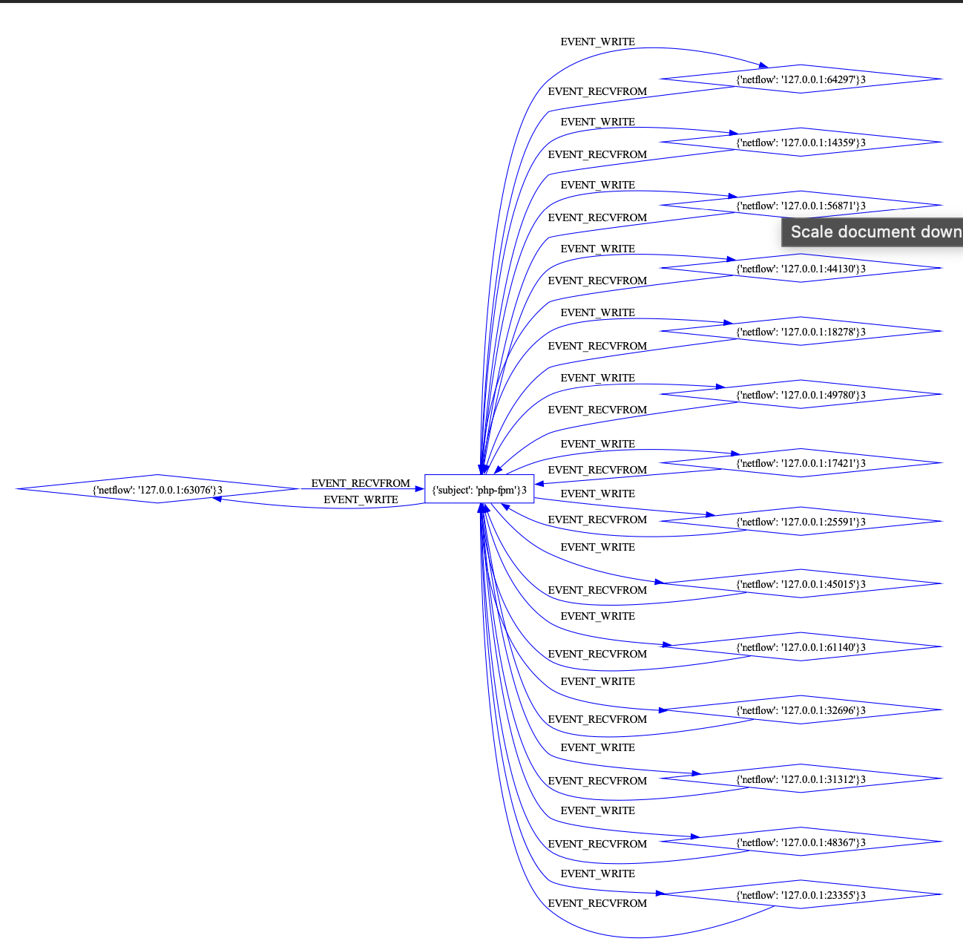

Running Existing Code E2E

Slide 21

Challenges and Learnings
Trained the model in the project - this took 5 hours
Manipulated the code.
Libraries/ packages for the code to run anomaly detection and attack investigation on RCSkills, technical insights, and teamwork.
Notes:
This project was a learning journey, from tackling technical challenges in running complex code to refining my ability to work collaboratively on usability explanations. It emphasized the importance of persistence and a systematic approach

Slide 22
Human Usability
Objective: Evaluate the effectiveness of XAI tools for improving real-world decision-making by cybersecurity professionals.
Participants:
Cybersecurity professionals at various experience levels (junior, mid-level, senior) and specifications (e.g., threat detection, mitigation)
Non-technical users, such as IT managers, compliance officers, or executive
Survey Questions:
Compare experience with XAI vs. traditional black-box models.
Suggestions for improving XAI for real-world use.
Were explanations helpful in avoiding mistakes?
Did explanations reduce decision-making time?
Are XAI outputs applicable to real-world scenarios?
Evaluation Metrics:
Expertise Level: How much domain-specific knowledge or training do you feel is needed to effectively understand and utilize the explanations provided by this system?
Rate complexity (1 = very easy, 5 = highly complex).
Explanation Type:
Categorize explanation formats (e.g., feature importance, heatmaps).
Coherence: Do the explanations align with your prior knowledge and understanding
Rate alignment with task expectations (1 = incoherent, 5 = highly consistent).
Actionability: How actionable do you find the explanations provided by the system.
Rate clarity for decision-making (1 = not actionable, 5 = immediately actionable).
Notes:
This project was a learning journey, from tackling technical challenges in running complex code to refining my ability to work collaboratively on usability explanations. It emphasized the importance of persistence and a systematic approach

Slide 23
Human Usability
Evaluation Metrics:
Trustworthiness: Do you trust the explanations to be accurate?
Survey or Likert scale (1 = no trust, 5 = high trust).
Consistency in Decision-Making: Evaluate if XAI helps maintain consistency across similar cases.
Present similar scenarios and analyze if users provide consistent decisions with explanations
Decision Latency: Measure the time taken to make decisions with and without explanations.
Record decision-making times during tasks and compare averages.
Confidence Boost: Assess if explanations improve users' confidence in decision-making.
Ask participants to rate their confidence before and after using XAI explanations.
Measure variance in decision confidence across cases.
References:
Nadeem, Azqa, et al. "Sok: Explainable machine learning for computer security applications." 2023 IEEE 8th European Symposium on Security and Privacy (EuroS&P). IEEE, 2023.
Bhusal, Dipkamal, et al. "Sok: Modeling explainability in security analytics for interpretability, trustworthiness, and usability." Proceedings of the 18th International Conference on Availability, Reliability and Security. 2023.
Wang et al., “Interpreting reinforcement learning policies with confidence”, 2020.
Suresh et al., “Human-centered interpretable machine learning: A perspective on human-algorithm interaction”, 2021
Notes:
This project was a learning journey, from tackling technical challenges in running complex code to refining my ability to work collaboratively on usability explanations. It emphasized the importance of persistence and a systematic approach

Slide 24
Challenges and Learnings
Researching and refining the RQ.
Debugging and running the code E2E on RC.
Verifying human usability explanations.
Skills, technical insights, and teamwork.
Notes:
This project was a learning journey, from tackling technical challenges in running complex code to refining my ability to work collaboratively on usability explanations. It emphasized the importance of persistence and a systematic approach

Slide 25
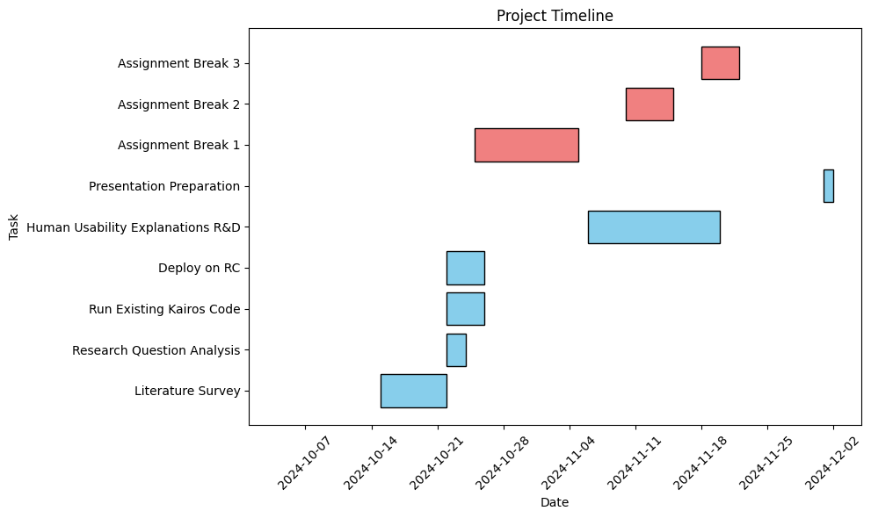
Project Timelines

Slide 26
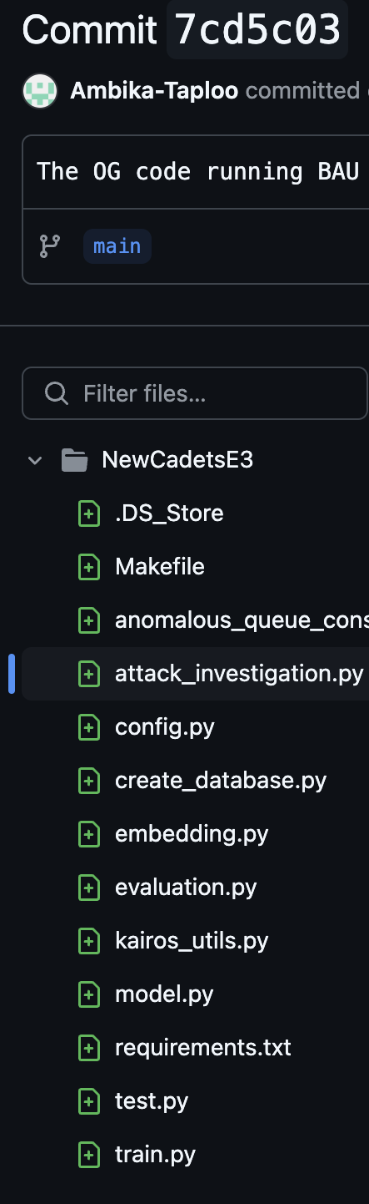
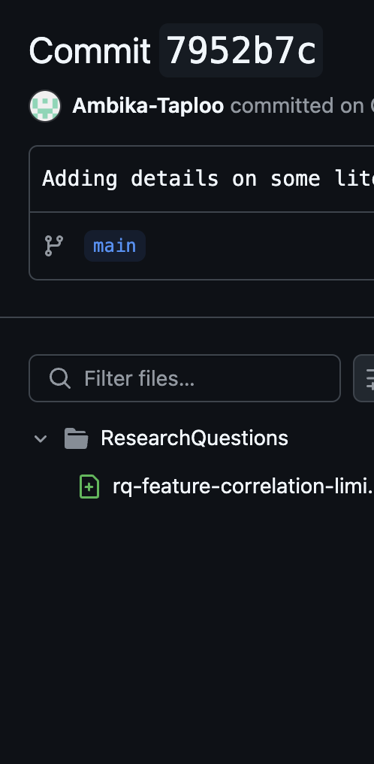
Commits

Slide 27
Thank You Q & A

